Slide 1
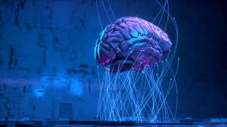
Next Word Prediction
Predictors
Aleemullah Khan 100846597(Section B)
Deep Mehta 100820114(Section B)
Prasann Patel 100833325(Section A)
Shail Patel 100846377(Section A)
Swati Pal 100845961(Section B)

Slide 2
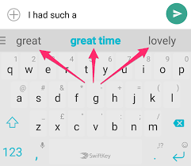
Introduction
An application that uses transformers models to predict the next word.
The goal is to showcase and compare the most popular models.
The first time you run the application, the models will need to be run and downloaded.
A model will analyze the sentence and predict the next possible word.
Analyzing the data will be followed by pre-processing.
Tokenizing the data will follow before we build the deep learning model.

Slide 3
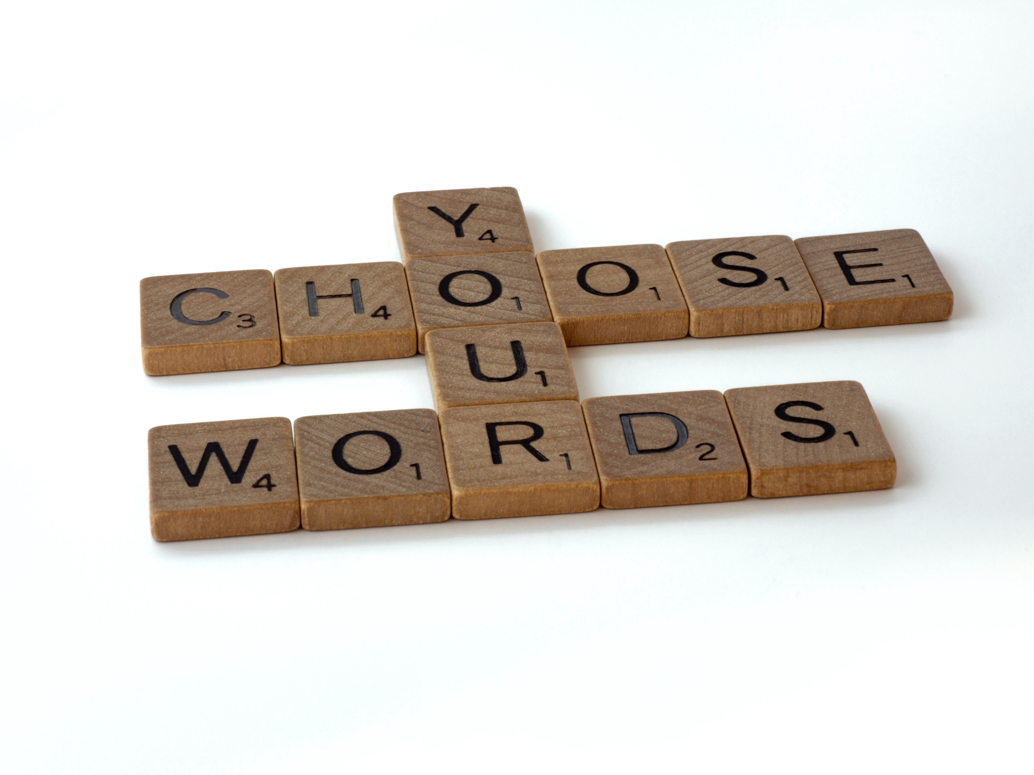
Objective
This app executes two variations of the same assignment (foresee token).
The primary one consider the conclusion of the sentence, reenacting a forecast of the another word of the sentence.
The moment variation is fundamental to incorporate a token where you need the show to anticipate the word.

Slide 4
Approch
Masked word prediction is a fundamental task for Transformer models. For example, BERT was pre-trained by using a combination of masked word prediction and next sentence prediction.
Although this task may seem simple, a deep understanding of language is required to complete it, making it an appealing choice for pre-training large language models.
State-of-the-art NLP Transformer models to perform masked word prediction.
Transformer is built on top of Hugging Face's Transformer's library, and allows programmers to implement and train Transformer models with just a few lines of code.

Slide 5
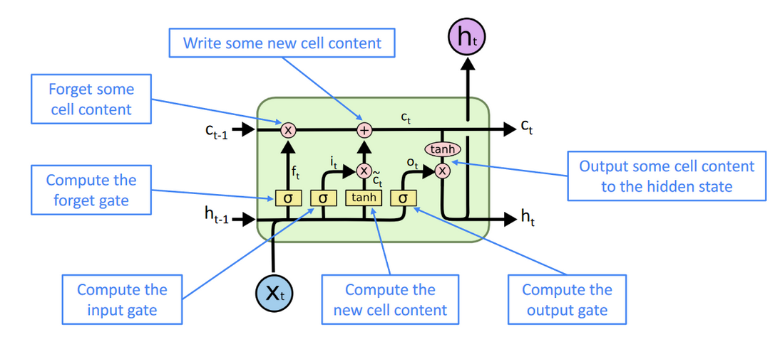
Architecture
Preprocessing dataset.
Tokenization: refers to splitting bigger text data, essays, or corpus’s into smaller segments.
The entire input sequence goes through the transformer model.
The output of the [CLS] token is transformed into a 2×1 shaped vector, using a simple classification layer (learned matrices of weights and biases).
Calculating the probability of IsNextSequence with softmax.

Slide 6
Data Preprocessing
The dataset is PBT taken from Kaggle.
Data Pre-processing is an integral step in developing a model as quality of the data affects the ability of our model to learn.
We have covered null values, standardization of data etc.
Consider each word only once and remove any additional repetitions.
Remove unnecessary and unwanted characters and words from sentences.
Tokenize the entire corpus and make a word_index (vocabulary).
Convert sentences into sequences based on their word_index.
Make a N_gram model for each sentence to get the best result.

Slide 7
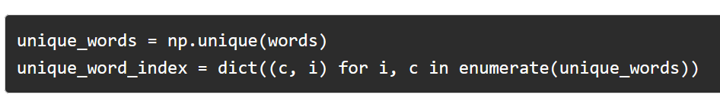
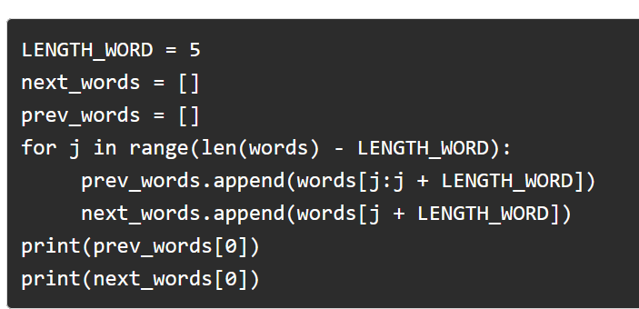
EDA
Exploratory data analysis helps in performing initial investigations on data in order to discover patterns, to spot anomalies with the help of summary statistics and graphical representation.

Slide 8
Implementation
A [CLS] token is inserted at the beginning of the first sentence and a [SEP] token is inserted at the end of each sentence.
A sentence embedding indicating Sentence A or Sentence B is added to each token. Sentence embeddings are similar in concept to token embeddings with a vocabulary of 2.
A positional embedding is added to each token to indicate its position in the sequence. The concept and implementation of positional embedding are presented in the Transformer paper.
The entire input sequence goes through the Transformer model.
The output of the [CLS] token is transformed into a 2×1 shaped vector, using a simple classification layer (learned matrices of weights and biases).
Calculating the probability of IsNextSequence with softmax.

Slide 9
Tools and Technologies
Python – primary language for the project with its packages and libraries.
NLP
PyTorch – Used this library to create Deep Neural Network using LSTM and fully connected layers, Glove word embedding.
Tensorflow
Keras
Numpy
Pandas

Slide 10
NLP Algorithm/ LSTM / N-GRAM LANGUAGE
NLP
Accurately extract information as well as categorize and organize.
Used for Classification.
Understand the exact problem.
LSTM
Long Short Term Memory used in the field of deep learning.
Special version of RNN.
Used in the handwriting recognition, speech recognition.
N-GRAM
Used in field of computational linguistics and probabilities.
Items can be phonems/syllables letters or words.

Slide 11
Result
Using a proper training data we can suggest more accurate word.
Analysing first word more precisely so that it can predict next word.
Use <Mask> to predict word between the sentence.
User can limit the prediction word limit from 1 to 10.
Accuracy for precisions top 1 is 45.3%, top 3 is 58.6% and top 10 is 72 %

Slide 12
Conclusion
Easy-to-use state-of-the-art models.
Lower compute costs, smaller carbon footprint.
Choose the right framework for every part of a model's lifetime.
Easily customize a model or an example to your needs.

Slide 13
Future Scope
Use more data from a variety of sources.
Utilize AWS services to optimize hyperparameters.
Develop a higher-quality web page for the end user to insert the word text.
The probability of a word being correct or false is exported as a result .

Slide 14



